Slide 1
Building an Interactive Wine Recommendation Application
Rutgers Data Science Bootcamp 2019
Maria Javier
Madeline Starr
Mark Visco

Slide 2
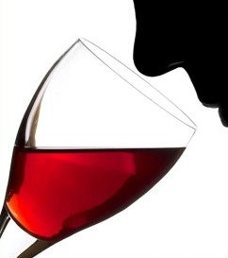
Talking about wine
Wine has a very complex flavor profile
The stereotype of wine tasting:
Swirling, nose in glass, slurping, spitting
“Flavor” = Taste + Aroma
Aromas are sensed externally and internally!

Slide 3
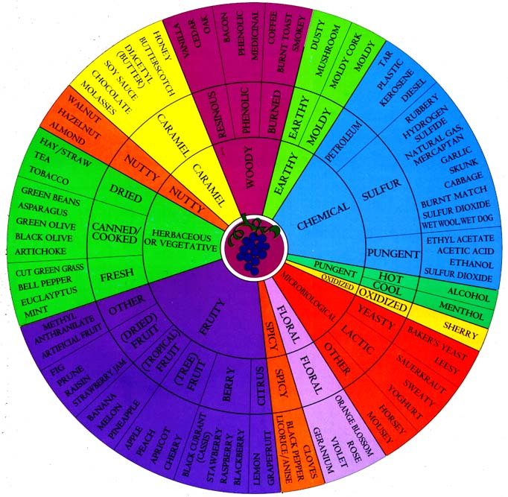
UC David Wine Aroma Wheel
People who talk about wines need a common lexicon
UC Davis originated the “Wine Aroma Wheel”
Groups and categorizes aromas common to wines
Covers both positive and negative attributes

Slide 4

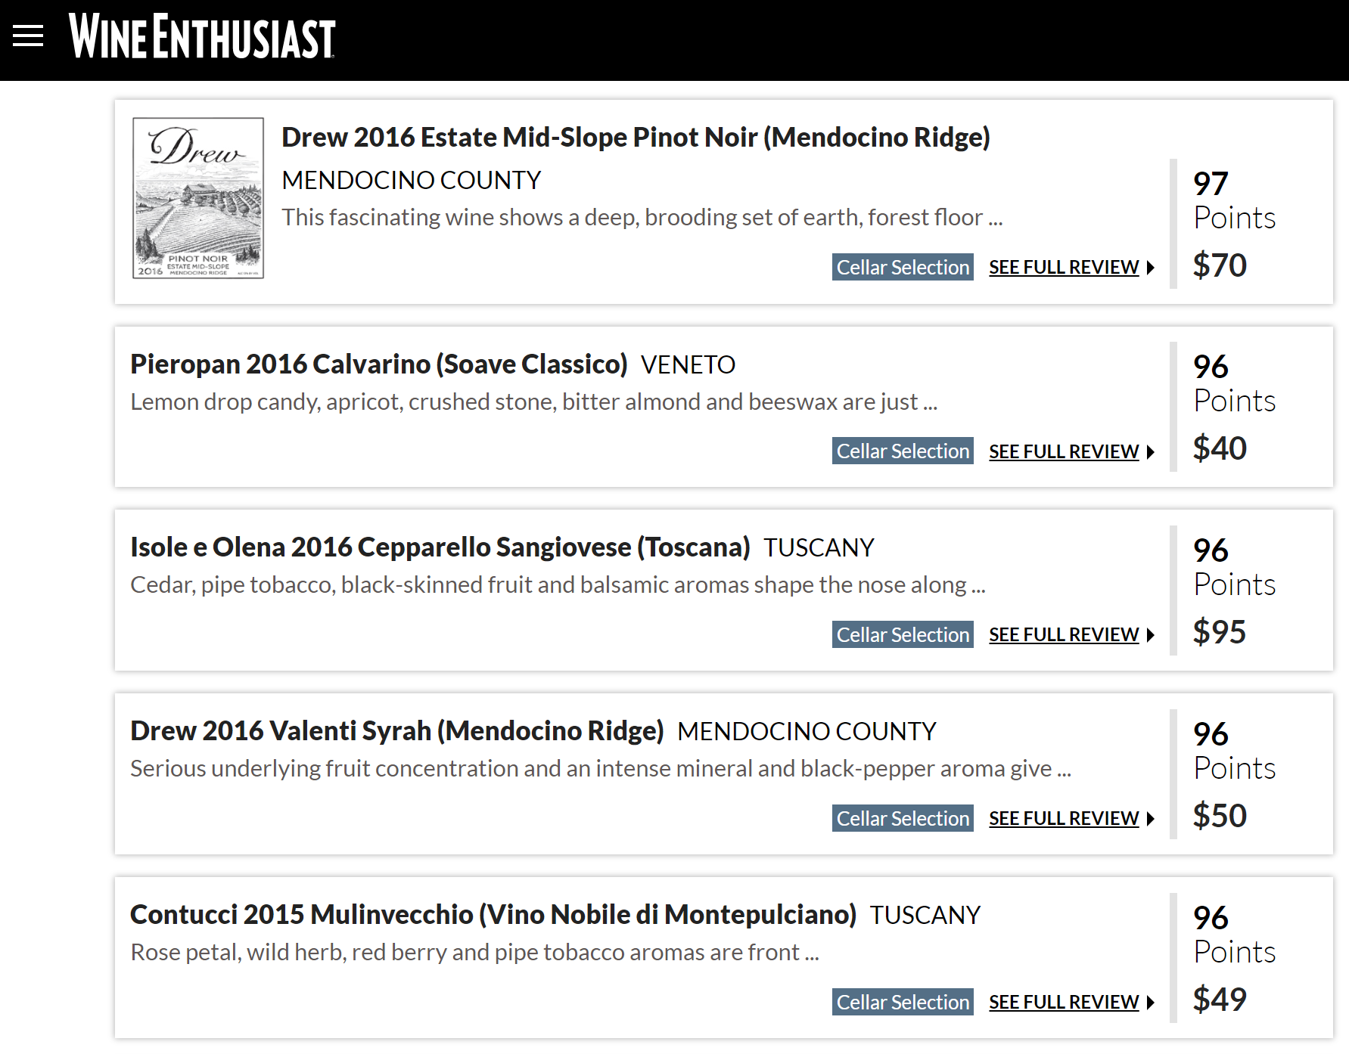
Wine Reviews

Slide 5
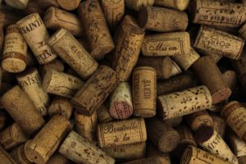
First step: Data munging
150,000+ reviews of 2017 wines, scraped and shared on Kaggle.com by Zack Thoutt
Data set included scores, winery, varietal, and full review text
Using Python, Pandas, and Jupiter notebook:
The text of the reviews was split into individual words and matched against the aromas listed on the Wine Wheel

Slide 6
Second step: Data munging (cont’d)
Files received included score and price average, wine counts and wine descriptions. Wine descriptions increased original 150k+ records to 400k+ records.
Using Postgresql :
Took the files from above and transformed them into groupings based upon the wine wheel categories.
Additional manipulation involved averages and concatenations along with column appending.

Slide 7
Third step: Website development
Putting together the website using files created in second step.
Used HTML, Flask, Javascript, CSS, D3 and SQLite.

Slide 8
Fourth step: Hosting our website
Uploaded all files to GitHub with proper formatting needed for Heroku.
Uploaded and linked to Heroku.

